Slide 1
Sorting
Sorting takes an unordered collection and makes it an ordered one.
1 2 3 4 5 6
77
42
35
12
101
5
1 2 3 4 5 6
5
12
35
42
77
101

Slide 2
Sorting
Following is the list of sorting algorithms which will be explained in this presentation:
Insertion Sort
Selection Sort
Bubble Sort.

Slide 3
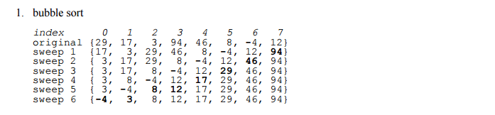
Bubble sort:
The bubble sort algorithm is one of the simplest sorting algorithms. It involves following steps:
a) Compare adjacent pairs of an array.
b) If the first is larger than the second, interchange the two elements.
c) Repeat the above two steps until the array is sorted in increasing order

Slide 4
void bubbleSort(int arr[],int n);
void main() {
int c[5]={6,8,1,5,2};
bubbleSort(c,5);
getch();
}
void bubbleSort(int arr[5],int n) {
int i,j,temp,pass=0,k;
for (i = 0; i < n; i++) {
printf("\n");
for( j = 0; j < n-1-i ; j++) {
if( arr[j] > arr[j+1]) {
temp = arr[j];
arr[j] = arr[j+1];
arr[j+1] = temp;
}//end if
} // end for
printf("After pass %d:\t",++pass);
for(k = 0; k < n; k++)
printf("%d\t",arr[k]);
} // end for
}

Slide 5
Insertion Sort
while some elements unsorted:
Using linear search, find the location in the sorted portion where the 1st element of the unsorted portion should be inserted
Move all the elements after the insertion location up one position to make space for the new element
45
38
60
45
66
60
45
66
79
47
13
74
36
21
94
22
57
16
29
81
the fourth iteration of this loop is shown here

Slide 6
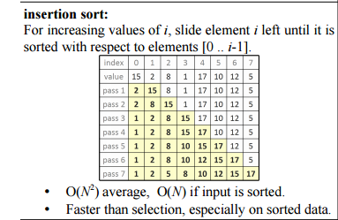
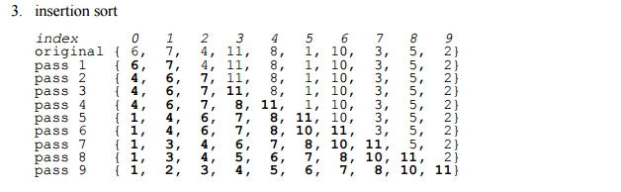
An insertion sort of an array of five integers

Slide 7
void insertionSort(int arr[],int n);
void main() {
int c[5]={5,1,8,3,4};
insertionSort(c,5);
getch();
}
void insertionSort(int arr[5],int n) {
int i,j,temp,pass=0,k;
for (i = 1; i < n; i++) {
printf("\n");
for( j = 0; j < i ; j++) {
if( arr[i] < arr[j]) {
temp = arr[i];
arr[i] = arr[j];
arr[j] = temp;
}//end if
} // end for
printf("After pass %d:\t",++pass);
for(k = 0; k < n; k++)
printf("%d\t",arr[k]);
} // end for
}

Slide 8
SELECTION SORT
Idea:
Find the smallest element in the array
Exchange it with the element in the first position
Find the second smallest element and exchange it with the element in the second position
Continue until the array is sorted

Slide 9
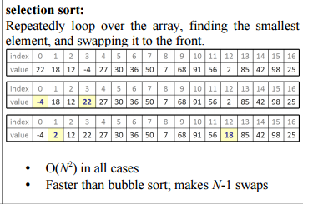
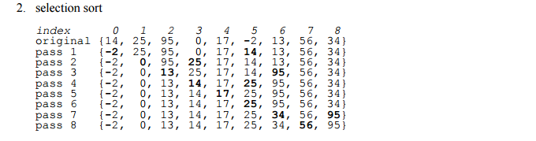

Slide 10
void selectionSort(int arr[],int n);
void main() {
int c[5]={5,1,8,3,4};
selectionSort(c,5);
getch(); }
void selectionSort(int arr[5],int n) {
int i,j,min,pass=0,k;
for (i = 0; i < n; i++) {
min = arr[i];
printf("\n");
for( j = i+1; j < n ; j++) {
if( arr[j] < min) {
min = arr[j];
arr[j] = arr[i];
arr[i] = min;
}//end if
} // end for
printf("After pass %d:\t",++pass);
for(k = 0; k < n; k++)
printf("%d\t",arr[k]);
} // end for
}

Slide 11
What is searching?
Searching means scanning though a list of items or records to find a particular one exists. It usually requires the user to specify the target item or target key. If the target item is found, the record or its location is returned, otherwise, an appropriate message or flag is returned. Basic searching algorithms are: Linear search (or Sequential Search) and Binary Search. Linear Search can be used for sorted and unsorted data both. Binary Search can be used only for sorted data. If we have sorted list of data use of binary search is more efficient in comparison to linear search

Slide 12
Linear Search:
This involves searching through the list sequentially until the target item is found or the list is exhausted. If the target is found, its location is returned, otherwise a flag such as –1 is returned.

Slide 13
Iterative Approach
int lin_search(int x[], int size, int key)
{ int k;
for(k=0; k<size; k++) {
if(key==x[k])
return 1;
}
return 0;
}
Recursive Approach
int recSearch(int arr[], int l, int r, int x)
{
if (r < l)
return -1;
if (arr[l] == x)
return l;
return recSearch(arr, l+1, r, x);
}

Slide 14
Binary Search
Binary search works by comparing the target with the item at the middle of the list. This leads to one of three results:
1. If the middle item is the target – we are done.
2. If the middle item is less than target in that case we apply the algorithm to the upper half of the list.
3. If the middle item is bigger than the target in that case we apply the algorithm to the lower half of the list.This process is repeated until the item is found or the list is exhausted.

Slide 15
Illustration of Binary search
X[12]:
Search for b=12
mid = (0+11)/2 = 5. Compare b with X[5]: 12<20.
So search in left half X[0..4]
mid = (0+4)/2 = 2. Compare b with X[2]: 12 > 7.
.
1
5
7
12
15
20
25
27
35
40
47
60
0
1
2
3
4
5
6
7
8
9
10
11
1
5
7
12
15
20
25
27
35
40
47
60
0
1
2
3
4
5
6
7
8
9
10
11

Slide 16
Illustration of Binary search
So search right half X[3..4]
mid = (3+4)/2 = 3.Compare b with X[3]: b=X[3]=12.
Return 3.
1
5
7
12
15
20
25
27
35
40
47
60
0
1
2
3
4
5
6
7
8
9
10
11
1
5
7
12
15
20
25
27
35
40
47
60
0
1
2
3
4
5
6
7
8
9
10
11

Slide 17
Iterative Approach
void main() {
int pos;
int c[5]={1,3,4,5,8};
pos = bin_search(c,0,4,3);
getch(); }
int bin_search(int x[], int low, int high, int target)
{ int middle;
while (low <= high) {
middle = (low + high)/2;
if (target == x[middle])
return (middle);
else if (x[middle] < target)
low = middle + 1;
else
high = middle – 1;
}
return (-1)
}

Slide 18
Recursive Approach
void main() {
int pos;
int c[5]={1,3,4,5,8};
pos = bin_search(c,0,4,3);
getch(); }
int bin_search(int x[], int low, int high, int target)
{ int middle;
if (low > high) /*base case1:target not found*/
return –1;
middle = (low + high)/2;
if (x[middle] == target)
return (middle); /*base case2:target found*/
else if (x[middle] < target)
return(bin_search2(x, middle+1,high,target)
else
return(bin_search2(x, low, middle-1,target)
}
return (-1); }

